Slide 1
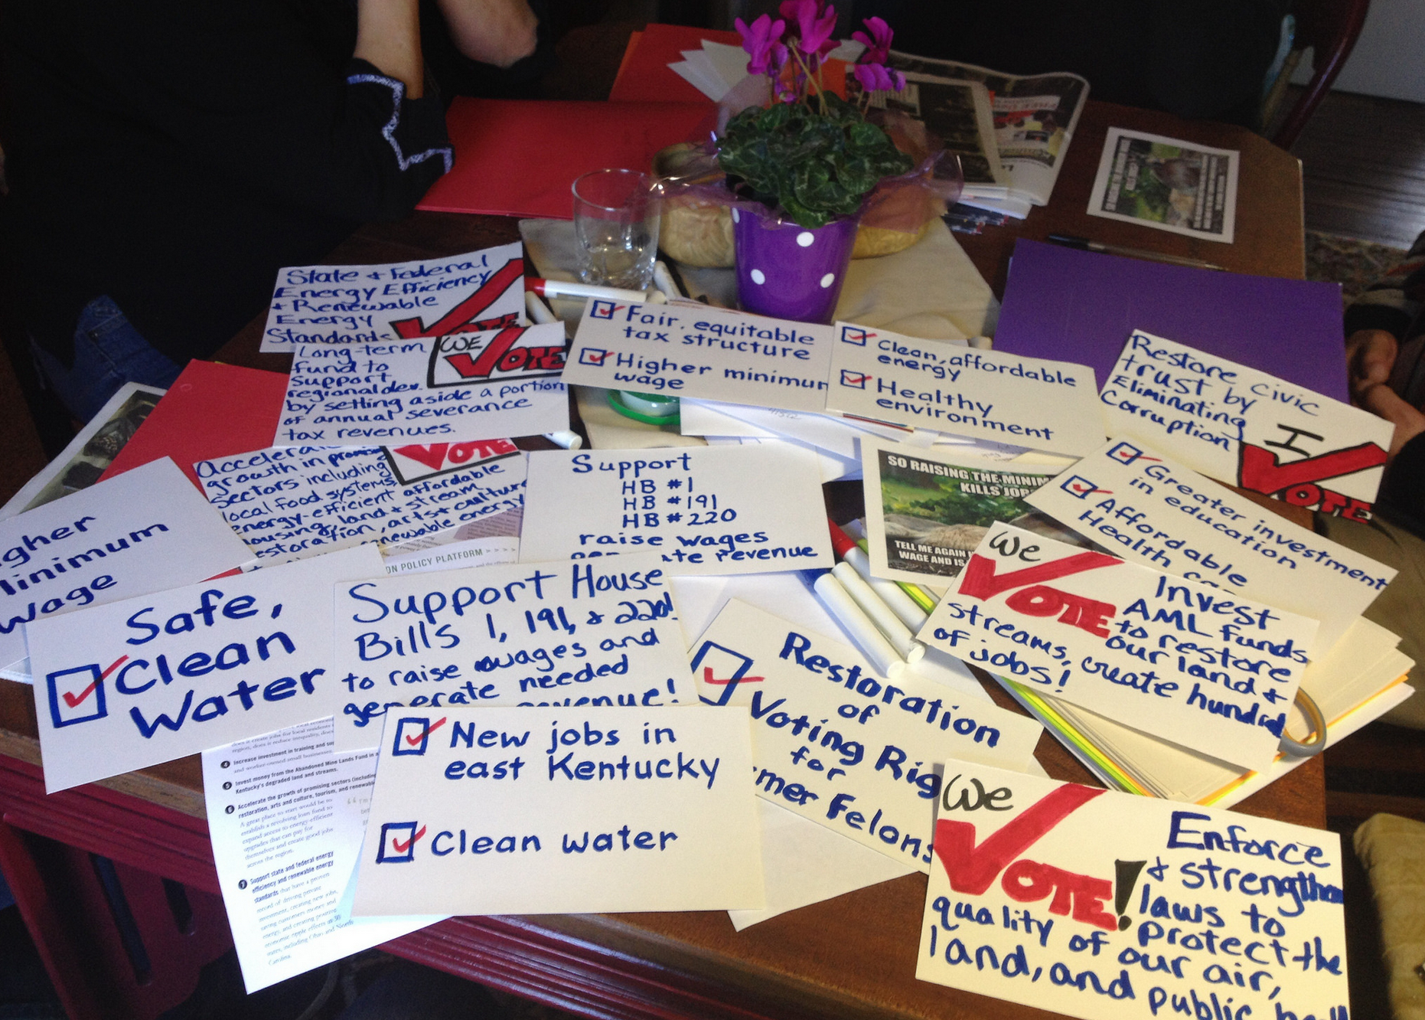
ILM Day 2014
Vote for Kentucky’s Bright Future!
Hosted by Kentuckians For The Commonwealth
Notes:
The theme for this year’s I Love Mountains Day is “Vote for Kentucky’s Bright Future!”

Slide 2
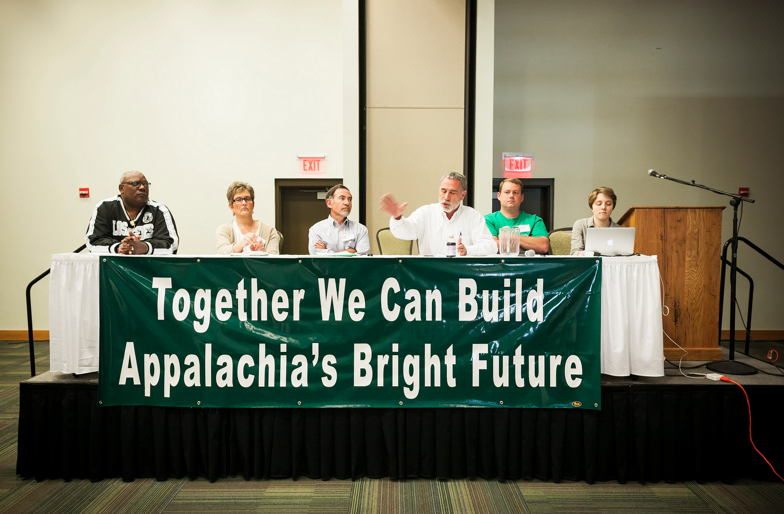
ILM Day 2014
Vote for Kentucky’s Bright Future!
Notes:
Why do we have an ILM Day each year?
Because we know we are Kentuckians, and we are our best hope for change. We believe that Kentucky can be a place where everyone – regardless of income, race, or position – has an equal voice. Where ordinary Kentuckians have a say in decisions affecting their lives. Where leaders listen and respond to community needs. Where decisions are made in the open, for the right reasons, and in everyone's interest. Where young people have opportunities, right here at home. And where our taxes are an investment in a brighter future.
And we are Kentuckians who believe in Appalachia’s bright future. Right now is our time to move forward together. Together we can build a diverse and healthy economy in eastern Kentucky, an economy with good jobs and opportunities for all our people. We can create new clean energy power, new economic power, and new political power across this commonwealth. And together we have to stop strip-mining and other destructive practices that rob us of our clean water, good soil, and health.

Slide 3
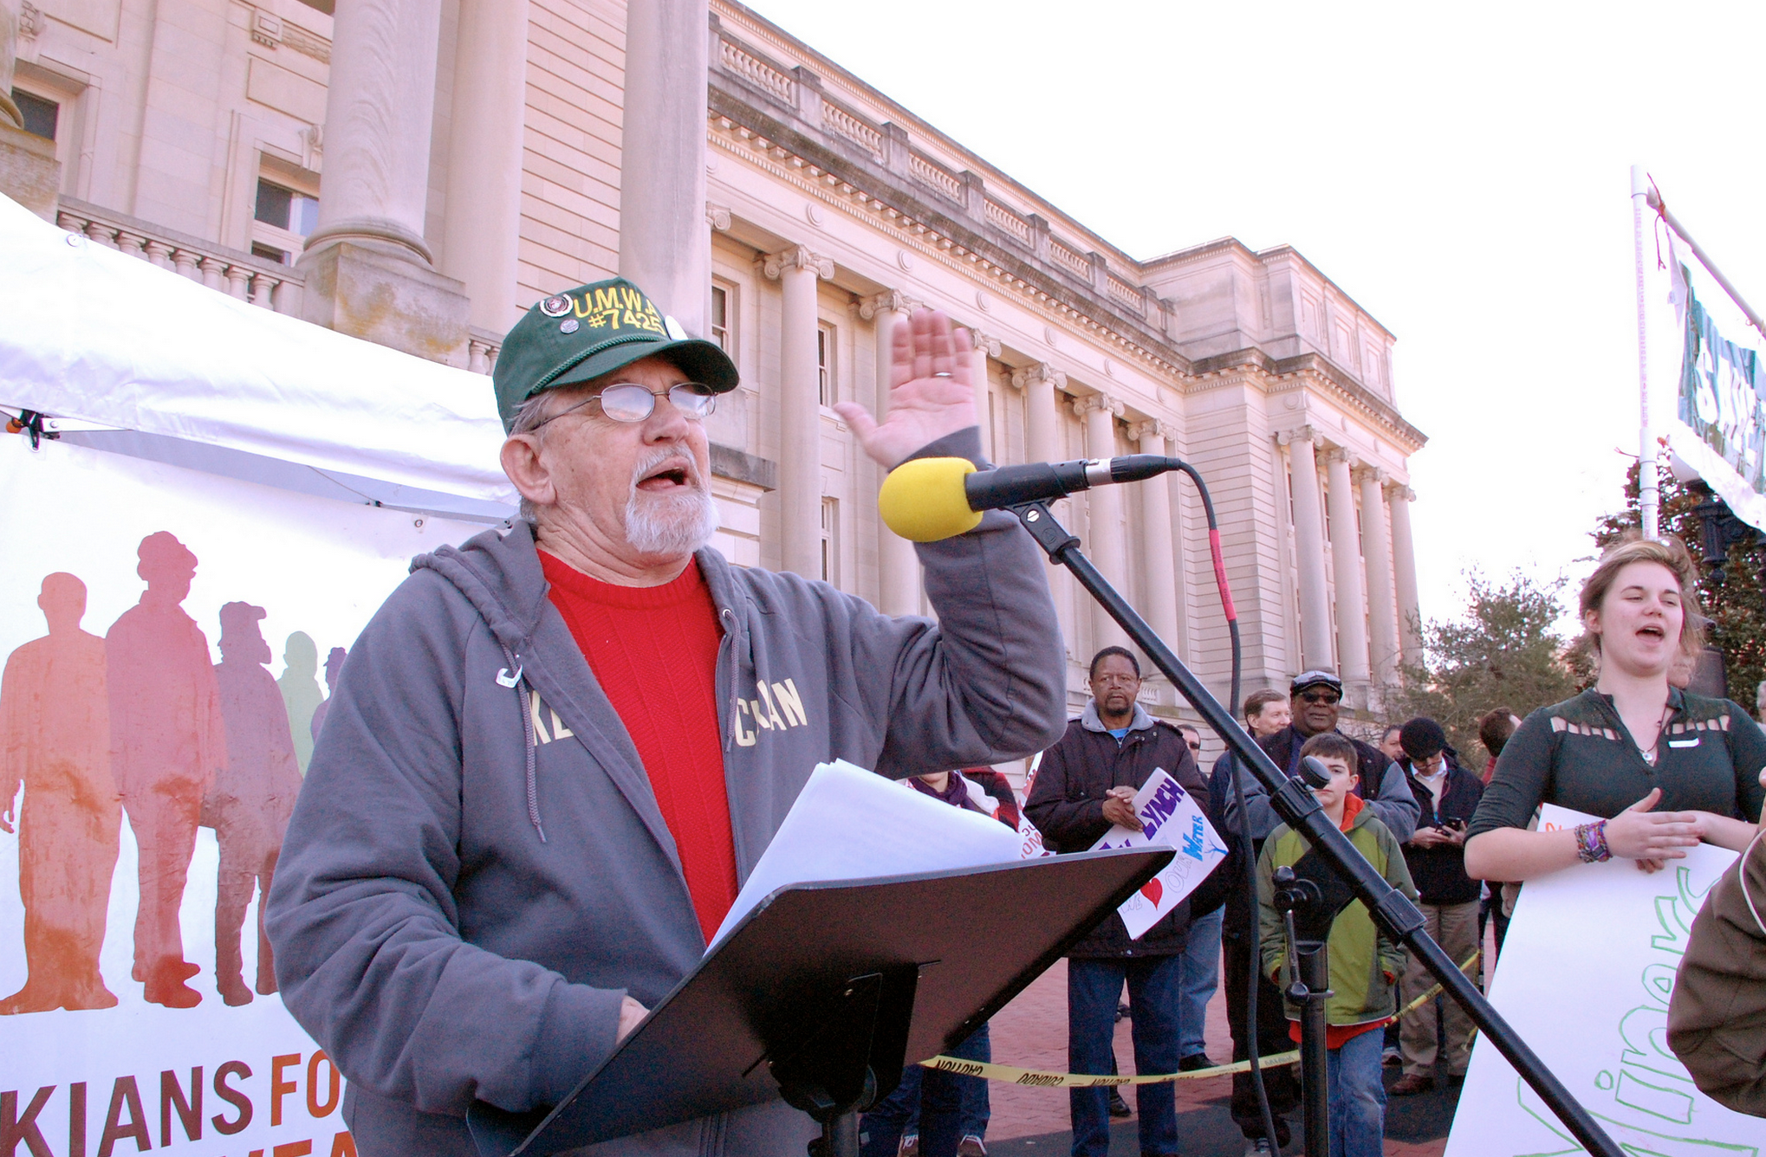
ILM Day 2014
Vote for Kentucky’s Bright Future!
Notes:
We have an opportunity to build a new economy, a healthy democracy, and a just transition
Eastern Kentucky’s economy is changing fast, and our future is unwritten. The Appalachian region is experiencing a dramatic transition. Coal production and employment are in steep decline and will continue to drop for years to come. We believe it’s essential that the transition to the new economy is a just transition—one that celebrates our culture and invests in communities and workers who depended on the old economy. An exciting conversation is happening across our region about the next economy in Appalachia, and we have worked hard to promote that conversation. Small businesses, farmers’ markets, artists and entrepreneurs are imagining together a diverse local economy that celebrates and preserves what we all love about eastern Kentucky. And we commend Gov Beshear and Congressman Rogers for joining this conversation by launching the Shaping Our Appalachian Region, or SOAR, initiative last fall.
Our Democracy is closely connected to our economy and ability to shape a bright future. As we heard from the stage last I Love Mountains Day, we must do more than just want a bright future. A bright future depends on strong community and political involvement: grassroots leaders, local residents, workers, public officials, and enterprises willing to envision another way forward. We believe we have the opportunity to move forward together, to build a new economy here in the mountains—a diverse, homegrown economy good for all people. We have to build it and protect it, together. We have to demand it and work for it every day. We have to organize for it and we have to vote for it.

Slide 4
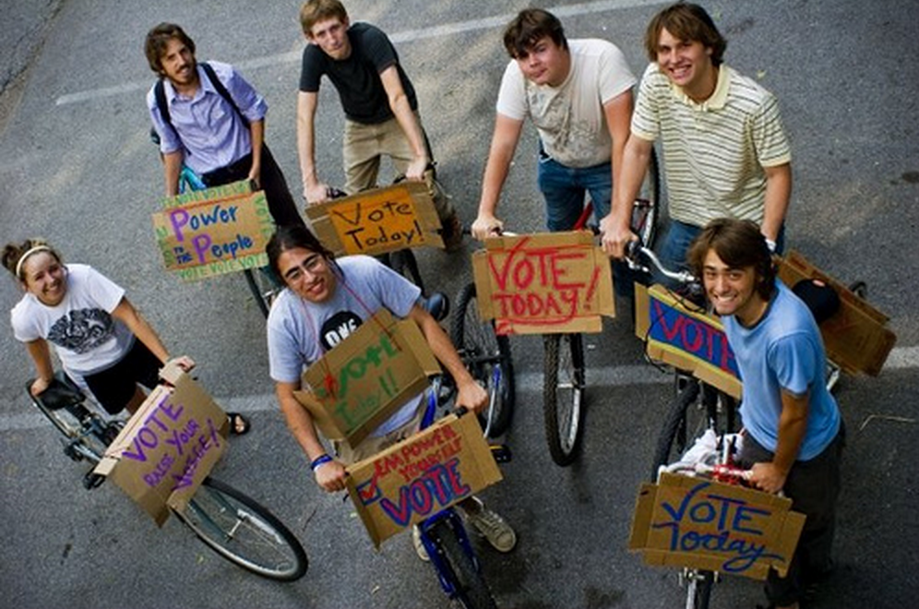
ILM Day 2014
Vote for Kentucky’s Bright Future!
Notes:
And we have to demand good people to vote for, candidates whose political future depends on caring about what’s good for our communities, not just their own gain or special interests. And we have to do what it takes to elect these good candidates – by voting and encouraging others to vote. This is an important election year in Kentucky, and it’s more important than ever that we use our power by voting.
We can and must shape our story and the transition toward a brighter future. Over the last few years, and at the SOAR summit in December in Pikeville, KFTC members have offered ideas and solutions based on principles of a just transition.

Slide 5
We believe a just transition must:
• Improve the quality of life for people and communities affected by economic disruption, environmental damage, and inequality
• Foster inclusion, participation and collaboration
• Generate good, stable, meaningful jobs and broad access to opportunities and benefits
• Promote innovation, self-reliance, and broadly held local wealth
• Protect and restore public health and our environment
• Respect the past while also strengthening communities and culture
• Consider the effects of decisions on future generations
Notes:
We can and must shape our story and the transition toward a brighter future. Over the last few years, and at the SOAR summit in December in Pikeville, KFTC members have offered ideas and solutions based on principles of a just transition. We believe that a just transition must:
• Improve the quality of life for people and communities affected by economic disruption, environmental damage, and inequality
• Foster inclusion, participation and collaboration
• Generate good, stable, meaningful jobs and broad access to opportunities and benefits
• Promote innovation, self-reliance, and broadly held local wealth
• Protect and restore public health and our environment
• Respect the past while also strengthening communities and culture
• Consider the effects of decisions on future generations

Slide 6
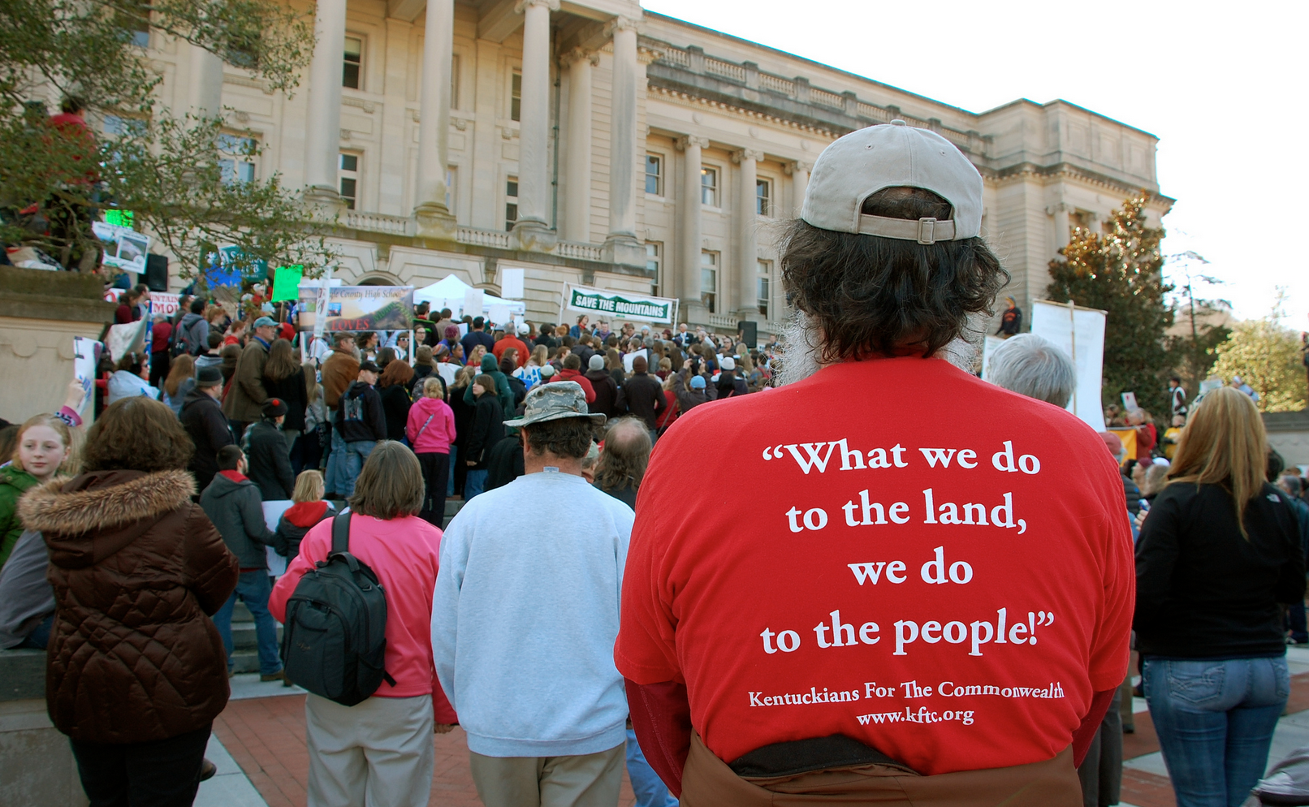
ILM Day 2014
Vote for Kentucky’s Bright Future!
Notes:
We have an urgent need to end the harm to our environment and health from mountaintop mining
“What we do to the land, we do to the people.” Recent studies indicate that mining communities in Appalachia have higher rates of cancer and birth defects than residents in nearby non-mining communities. Our land and people are suffering from widespread and permanent ecological destruction caused by mountaintop removal and other forms of large-scale surface mining.

Slide 7
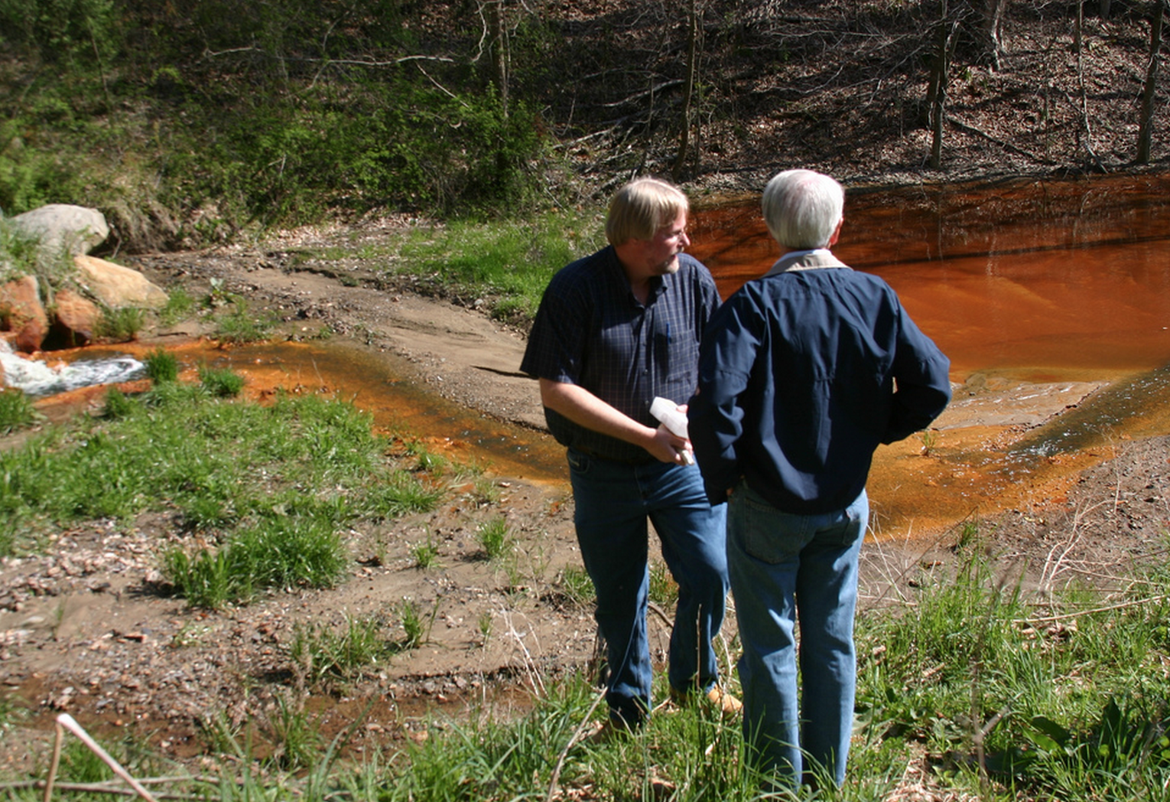
ILM Day 2014
Vote for Kentucky’s Bright Future!
Notes:
We demand an end to the destruction of our land, water and people in eastern Kentucky. For more than a century, our coal miners and the coal from our mountains have fueled the entire country. Now it’s time to invest in our region, in a just transition to a diverse and healthy economy in eastern Kentucky.

Slide 8
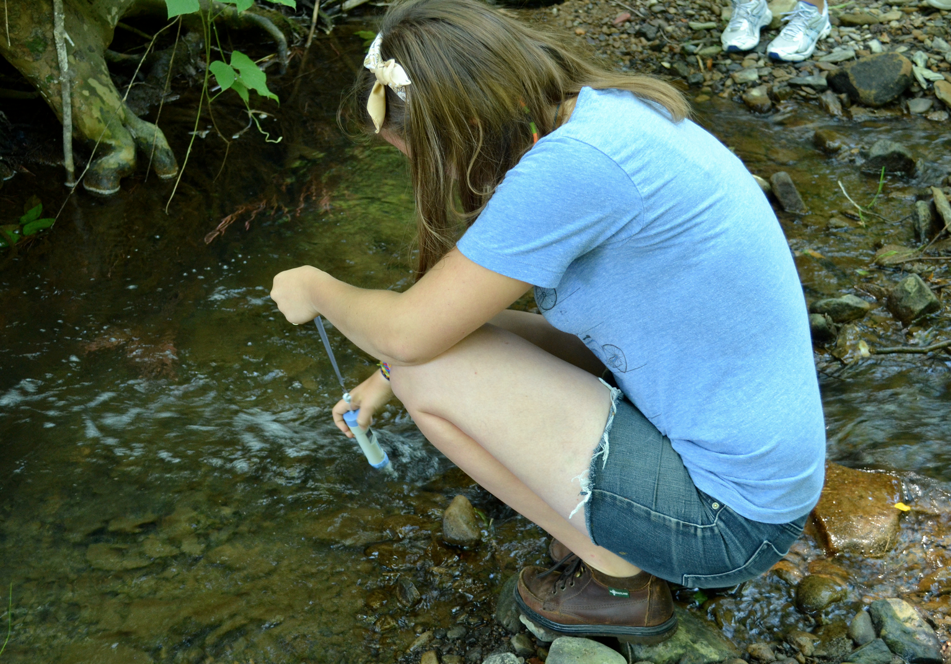
ILM Day 2014
Vote for Kentucky’s Bright Future!
Notes:
KFTC members and allies are documenting mining pollution and pushing hard to win full enforcement of laws and strengthen existing laws. Using a simple conductivity test, KFTC members can determine the health of a stream. Where problems exist, we look for specific chemicals. And we’ve begun to take samples from public drinking water systems as well. In the past two years, we trained and equipped more than 100 people in basic water testing skills. Together we’re learning the ins and outs of water quality laws, and with that knowledge, we’re holding coal companies accountable and building community power.

Slide 9
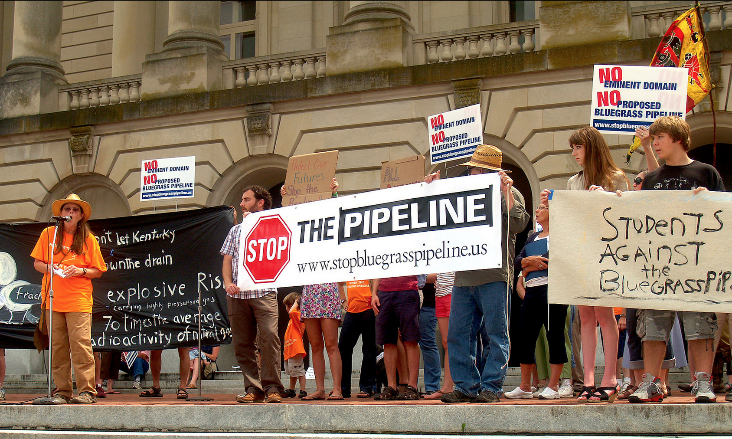
ILM Day 2014
Vote for Kentucky’s Bright Future!
Notes:
The challenges of communities in eastern Kentucky are closely related to environmental justice issues across our state and region. KFTC members are involved in efforts to oppose hazardous liquids pipelines through several dozen Kentucky counties. Working together, they’ve persuaded local governments in several counties to pass resolutions opposing the proposed Bluegrass Pipeline. And our members are working with their neighbors in Louisville to protect communities from harmful coal ash dumps. All of these are environmental justice issues caused by extractive industries.

Slide 10
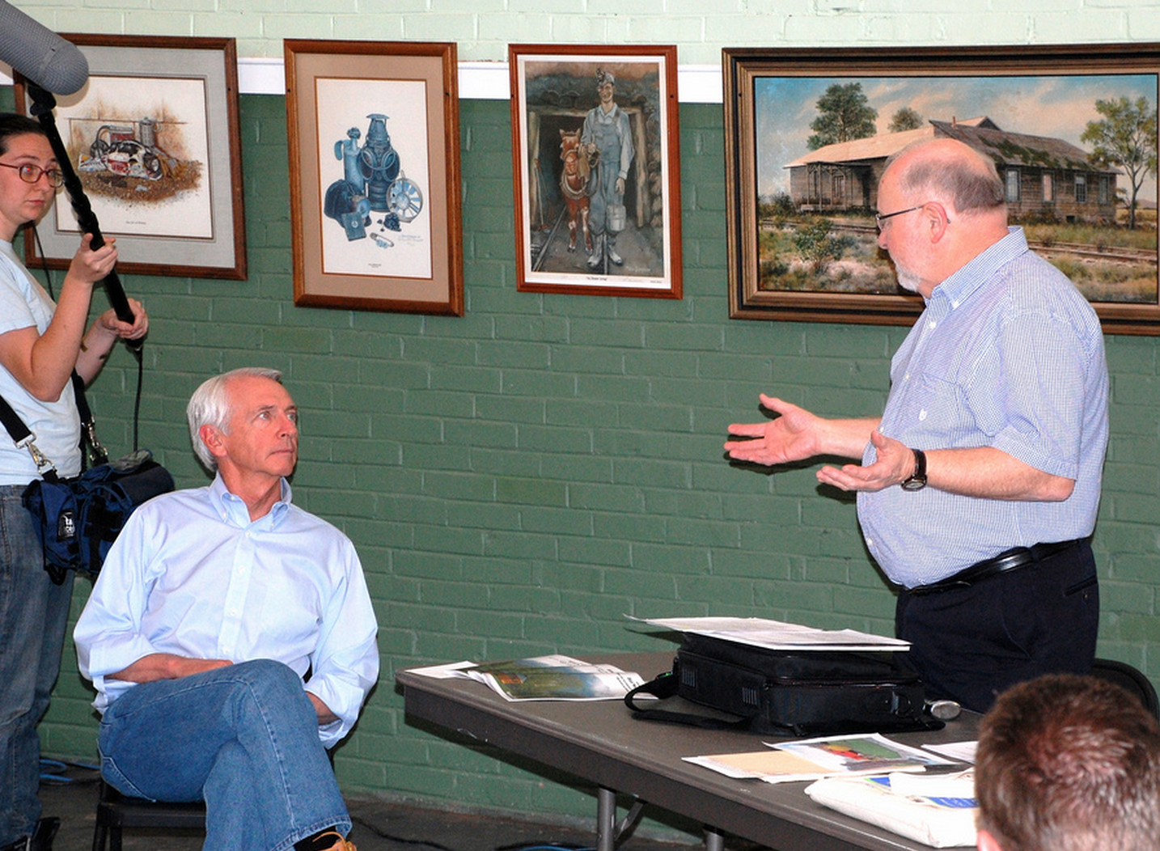
ILM Day 2014
Vote for Kentucky’s Bright Future!
Notes:
We’re making progress, but steps taken by state and federal officials are not enough. Our efforts – and yours – are making a difference. The US EPA is objecting to numerous water pollution permits that don’t comply with the law or protect our health. We reached a major settlement in a case involving a coal company that turned in tens of thousands of false pollution discharge records. We celebrate these steps forward. But as long as Kentucky is still rubber-stamping thousands of water pollution permits and weakening water quality standards, we are not satisfied. As long as toxic pollution runs unchecked down Raccoon Creek and so many other headwater streams, we are not satisfied. As long as residents of eastern Kentucky suffer from higher rates of cancer and birth defects than their neighbors in non-coal counties, we are not satisfied. As long as we allow our state to be vulnerable to, and land be taken for, hazardous liquids pipelines, we are not satisfied. And as long as our friends in West Virginia can’t drink their water because it’s been polluted by chemicals used to clean coal, we are not satisfied.

Slide 11
Our message to the Governor and other elected officials:
Invest in a new economy and just transition in eastern Kentucky.
Protect our health and stop the destruction of eastern Kentucky
Pass the Clean Energy Opportunity Act
Support the EPA and Mine Safety Administration
Stop the bad bills and pass the ones that are good and improve the quality of life for all Kentuckians.
Notes:
Our message to Governor Beshear and other elected leaders:
--Invest in a new economy and just transition in eastern Kentucky. The SOAR initiative is an important start. But the process really matters and must be more open and inclusive of ordinary Kentuckians, including women, young people, and the under- and unemployed. Comprehensive tax reform, including our severance tax, would be a strong step toward funding this investment.
--Protect our health and stop the destruction of eastern Kentucky. Start today by passing the Stream Saver Bill. Enforce existing mining and water quality laws. Make 2014 the year when Kentucky stops using the 402 General Coal permit, a rubber-stamp process that is responsible for massive, ongoing pollution of our headwater streams from surface mining.
--Pass the Clean Energy Opportunity Act, a bill that could create 28,000 new jobs over the next ten years here in Kentucky and help all of us save money by saving energy.
--Support the EPA and Mine Safety Administration and stop blocking their efforts to protect our workers, health, water, and climate.
--Stop the bad bills and support the good ones that improve the quality of life for all Kentuckians.

Slide 12
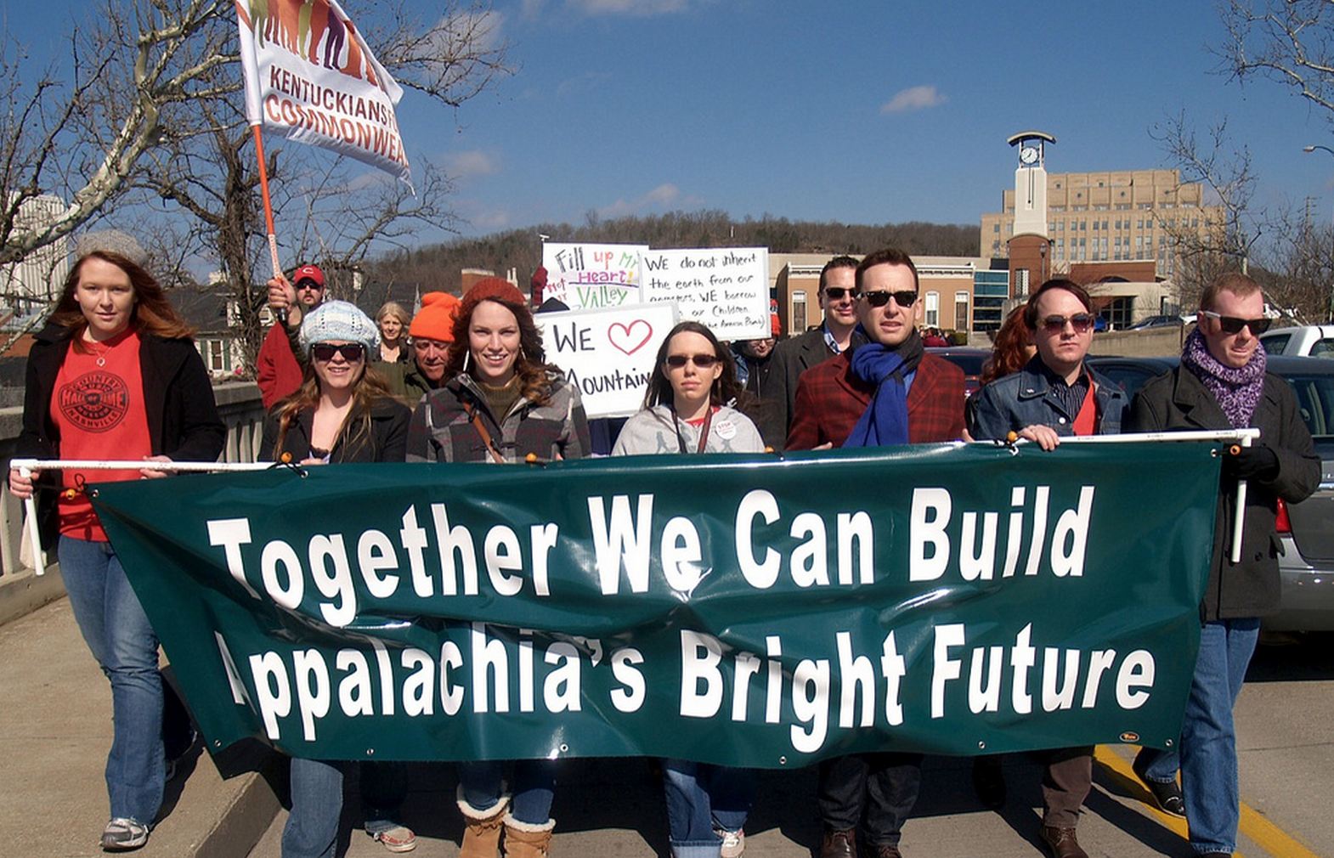
ILM Day 2014
Vote for Kentucky’s Bright Future!
Notes:
It takes all of us, working together, to make change for the better. On this February 12th, join us in giving love and thanks to our elders, friends, neighbors, and each other. We’ll gather at the Kentucky River to celebrate our steps forward, our courage to keep going, and our growing opportunity for a bright future. We will march together to the Capitol to show our strength, demand a better Kentucky, and hear mountain wisdom from the stage through song and speech.
To grow a healthy democracy and build a bright future, we have to work together. It’s up to us, and the time is now.

Slide 13
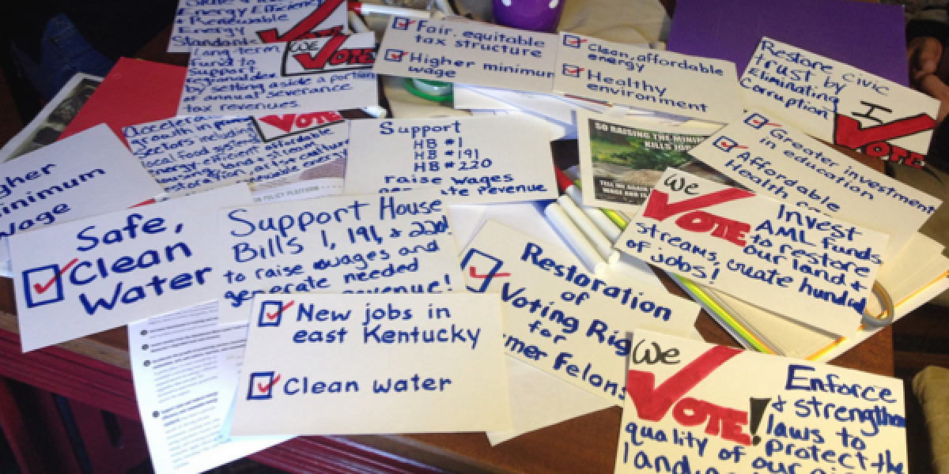
Cast your vote for Kentucky’s bright future: www.kftc.org/love
Notes:
Please take a moment to cast your vote for Kentucky’s bright future. Use the form at kftc.org/love (click on “vote now”) to tell us about key ideas, policies or values you want to be able to vote FOR in upcoming elections.
If you plan to attend I Love Mountains Day this year, we encourage you to also write or draw your ideas and bring them with you. We’ll attach these handmade signs to a large display banner, along with many of the ideas we receive online. Later, after the day is over, we’ll summarize and share the great ideas we receive with candidates running for office in Kentucky.
Guidelines for voting:
Please use fewer than 75 words per vote.
Tell us the ideas, policies or values you want to vote for – not things you are against.
Do not name names. Please tell us what, not who, you want to vote for.
If you are coming to I Love Mountains Day, please write or draw your ideas on paper no bigger than 5.5 x 8.5 inches and bring those with you. Be creative and colorful!
You can vote more than once.

Slide 14
ILM Day 2014
Schedule of activities
9 a.m. to Noon - Members and groups meet with lawmakers.
Noon - Gather at the Kentucky River
12:30 p.m. - March from the river to the capitol steps
1:15 p.m. to 2 p.m. - Rally on the capitol steps

Slide 15
Key provisions of the Clean Energy Opportunity Act – HB 195
Notes:
1. Asks utilities to meet a growing share of their energy needs from energy efficiency programs and renewable energy sources.
Renewable & Efficiency Portfolio standard (REPS)
2. Expands in-state renewable energy production by paying customers for renewable energy they generate at rates set by PSC.
Feed-in tariff

Slide 16
Key provisions of the Stream Saver Bill – HB 288
HB 288, the Stream Saver Bill, would protect our waterways by prohibiting the dumping of mine wastes into any “intermittent, perennial, or ephemeral stream or other water of the Commonwealth.” Mine wastes would be placed back on the mine site as part of the reclamation process already specified in state and federal law — rather than dumped over the side of the hill into valleys and streams and communities below.
Notes:
HB 288, the Stream Saver Bill, would protect our waterways by prohibiting the dumping of mine wastes into any “intermittent, perennial, or ephemeral stream or other water of the Commonwealth.” Mine wastes would be placed back on the mine site as part of the reclamation process already specified in state and federal law — rather than dumped over the side of the hill into valleys and streams and communities below.

Slide 17
ILM Day 2014
Social Media:
#lovemtns
On the web:
www.kftc.org/love

Slide 18
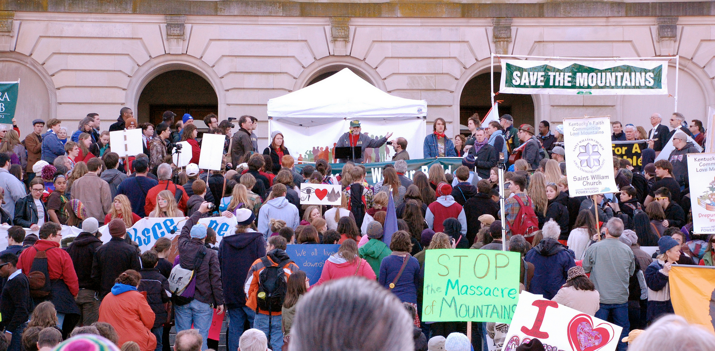
ILM Day 2014
Vote for Kentucky’s Bright Future!
See you there!

