Slide 1
Insights from Drafting & Passage of North Carolina’s REPS Law (SB3)
A Story of Outmoded Utility Regulation & Profit Model Running into Opportunity of the New Global Energy Economy, Security and Jobs
Ivan Urlaub
Executive Director
NC Sustainable Energy Association
Kentucky via Skype from North Carolina
January 31, 2011

Slide 2
Renewable Portfolio Standards in our global energy economy
29 states have an RPS;
6 states have an RE goal
State RPS
State Goal
Source: Database for State Incentives for Renewables and Efficiency. November 2009. www.dsireusa.org
Source: DSIRE database, REPS, 2010

Slide 3
Pre-REPS Policy – Lessons Learned
2003 – 2007
Voluntary Green Power Pricing Program (‘03)
Net metering rule – rule insufficient, only one subscriber (‘05)
Interconnection Standard <100kW (‘05)
Clarified RECs belong to customer-generator, utility cannot take (‘05)
Commercial investment tax credit increased to $2.5 million (‘05)
Efficiency added to utility Integrated Resource Plans (‘06)
NCUC changes rules, must include efficiency in long-term plan (‘06)
“La Capra Study” of requiring RE and EE in NC (‘06)
  EE + RE will cost less than coal, natural gas and nuclear
1st REPS in Southeast, 25th in U.S. (‘07)
Source: Ivan Urlaub, NC Sustainable Energy Association. 2011
Notes:
Study needs to be done again, now that there are more trasnparent costs for new baseload generation and solar and many bioenergy costs have declined significantly.

Slide 4
REPS Utility Compliance
2008 to 2018: Renewable Energy = 75%, Energy Efficiency = 25%
REPS will only deliver about 5.6% RE and 5% EE “in state” by 2021
Ivan Urlaub, NCSEA. Duke University, Nicholas School. Sep 15, 2010

Slide 5
REPS Coops & Munis Compliance
2008 to 2018: They can comply entirely with efficiency, load shifting
Ivan Urlaub, NCSEA. 2011

Slide 6
Story of SB3
REPS Study Bill and lobbying, 2005
REPS “La Capra” Study, 2006
Study reveals EE + RE cheaper than coal + natural gas +/- nuclear
Utilities wanted CWIP for coal, nuclear
REPS law as part of “Senate Bill 3” Compromise with Duke & Progress Energy
90+ stakeholders negotiated bill over 7 months and 100+ large and small meetings
Stakeholder concerns nearly all addressed

Slide 7
Key findings of NCUC Study
La Capra study, cost for 2007 – 2017:
  7.5% from RE + 2.5% from EE costs less than coal and natural gas to meet same need in 2017
  10% REPS costs less than new nuclear if nuclear costs $3,000/kW or more – new Fed estimate is $5,000/kW
  Some nuclear facilities under construction are on a path to exceed $7,500/kW
The more EE you commit to, the more cost effective your REPS policy becomes
  NC has potential to meet 13% of electric demand in 2017 with EE costing less than 5 cents / kWh
New power plants cost more than existing
La Capra Associates, Analysis of the impact of the North Carolina Renewable Energy and Energy Efficiency Portfolio Standard for the State of North Carolina
Ivan Urlaub, NCSEA. Duke University, Nicholas School. Sep 15, 2010

Slide 8
Regulated Electricity Markets
“Regulated” States and the renewable invasion
Deregulated
Regulated
Regulated state policy: Energy policy change must address barriers, such as lack of transparency and perverse incentives, that are unique to regulated states. Competitors in New England, Mid-Atlantic and CA do not face these same barriers.
Source: US Energy Information Administration.
Notes:
In the Southeast, and actually in a majority of U.S. states, the electricity market is regulated. This means one or more large Investor Owned Utilities are given a service territory and guaranteed profit in exchange for a commitment to deliver reliable, least cost energy to their customers. Duke Energy, Southern Company’s many state subsidiaries, Progress Energy are examples of an IOU.
To summarize crudely, the way an IOU optimizes the market for their shareholders is to generate the highest, predictable level of sales revenue and earnings per share utilizing generation, transmission and distribution assets they can control through ownership and operation.
IOUs are the trusted source of energy information, because they have reliably delivered electricity, the backbone of the economy for many decades. They have sponsored little league teams, community events and high profile basketball games for the entire lifespan of many Southeast citizens. They fund campaigns and have the loyalty of many business leaders because they have used the regulatory system to develop special rate ryders to cut the electric rates of large employers, which in turn makes politicians happy. And this trust has been leveraged to tweak law over the years to a point where there is little to no transparency in the regulation, reporting and renewable energy implementation of the electric utilities.
Renewable energy myths have been perpetuated by the IOUs for many years to protect their market against invasion of electric generation systems that the utility may not own and operate. Allowing renewable energy to get a toe hold in an IOU service territory is the proverbial camel’s nose under the tent – once people find a way to finance renewables, and if they embrace the presence of the technology in their community(ies), then the utility will either have to come up with a new strategy and tactics to halt adoption of renewables or find a way to make a predictable profit off of taking over the renewables market themselves.
The rural areas are served by rural electric membership cooperatives and municipalities. The percent of a Southeast state’s population served by an investor owned utility ranges from about 15% to more than 50%. These smaller service providers are only partially regulated by the states, often limited to reporting formalities.
In a regulated state, a utility is motivated to perpetuate myths
The optimal business model for an IOU is defined by regulation. The Utilities are only doing what law and regulation has instructed them to do in order to satisfy their shareholders – right now in much of the Southeast that is slow or stop the progress of renewables and energy efficiency. Where they have failed, such as Duke Energy, they are trying to rewrite the rules to make a profit off of controlling the growing renewables and efficiency markets.
To be effective in legislation, an advocate or group of advocates must be a trusted substitute source of information that challenges the utility think speak and misleading information.

Slide 9
Example of a regulated “free” market:
Energy Efficiency
Who implements EE and RE matters:
  Utility: charge ratepayers more than coal, nuclear
  Electric coop: members pay less in long run
  EE Biz install efficiency for customer:
  reduction in monthly utility bill, quick payback
  Homeowner installs: lower energy cost
  Build Efficient & “Solar-ready”: least cost option
Least cost options of the new energy economy are outside the scope of regulators.
If more EE but do not change regulatory rate structure: utility earns less revenue, less profit, and lower earnings per share; all three become less predictable for utility shareholders/investors
Ivan Urlaub, NCSEA. 2011

Slide 10
Impact of SB3 since 2007
36% and 22% job growth in ’08 and ’09
From 485 firms to 1,200 firms in 3 years
Majority of EE/RE jobs in R&D, Manufacturing
NC ranked 10th in new solar capacity ’08 and ’09
World’s two largest solar thermal installs
300 MW wind farm filed for CPCN last week
NC national hub for smart grid, energy storage

Slide 11
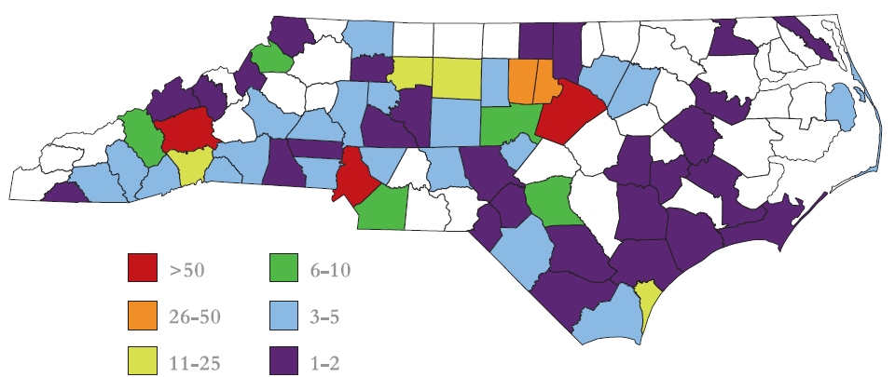
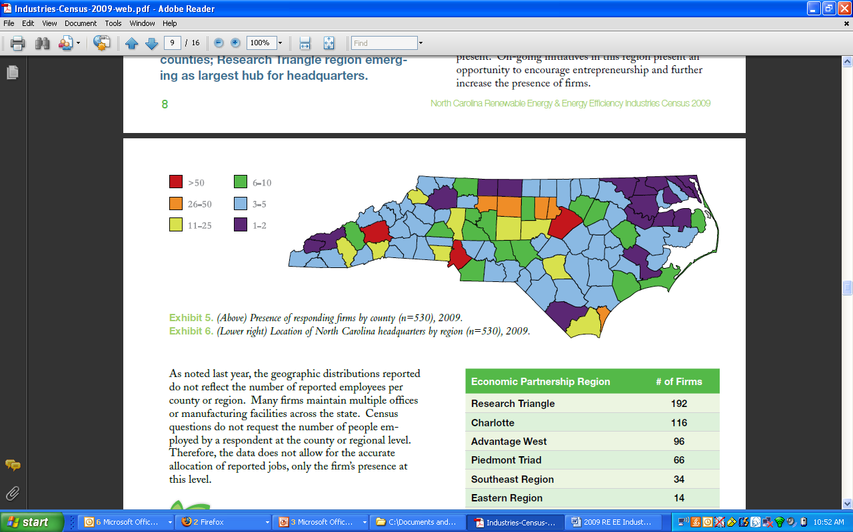

NC EE and RE Industries Census
Presence of Responding Firms by North Carolina County
2008 (n=163 replies)
485 firms surveyed
~6, 400 FTE jobs
2009 (n=530 replies)
1,100+ firms surveyed
~10,250 FTE jobs
Source: NCSEA, 2009 Industries Census. http://energync.org/media/09%20Industries%20Census.pdf
Notes:
11

Slide 12
NC Green Energy Jobs
Efficiency and Renewables
Ivan Urlaub, NCSEA. Sep 15, 2010
Notes:
12

Slide 13
Policy Drivers of NC EE/RE Market
2007 – Present
REPS Rules, Clarifications, Cost Recovery, Plans (’07-’10)
Interconnection Standard revised, expanded to 10 MW (’08)
Performance Contracting ceiling raised to $500 million (‘08)
Local wind power ordinances adopted (’08 to ’10)
Stakeholder conflicts on biomass definition persist (’09 to present)
RECs tracking system – NC RETS online at www.ncuc.net (’08 to ’10)
RE Tax Credit extension to 2016, expansion to geothermal (’09)
Failed feed in tariff study (’09)
RE Tax Credit expansion to CHP, no tax on 1603 grant (’10)
RE Manufacturing tax credit – end product & subassembly (’10)
Source: Ivan Urlaub, NC Sustainable Energy Association. 9/8/2010

Slide 14
Global Opportunity can be Local
Annual Clean Energy Investment, Total Jobs
2004 new investment: $46 billion
2009 new investment: $162 billion
2010 Forecast: $175 billion - $200 billion
2019 Forecast: $325 billion
Comparison: NC is $400 billion of US GDP
Jobs in subset of solar and wind:
  2009: 831,000 jobs
  2019 Projection: 3.3 million jobs
Source: Bloomberg New Energy Finance, March 2010. http://www.cleanedge.com/reports/charts-reports-trends2010.php

Slide 15

Thank you for your interest
  Ivan Urlaub
  Executive Director
  NC Sustainable Energy Association
  919.832.7601 ext. 102
  ivan@enegync.org
© Do not replicate content without permission of Ivan Urlaub, NCSEA.

Slide 16
Slides for discussion if needed

Slide 17
Lesson Learned:
Might is Not Right, but Information Is
Decide what type of information you will provide:
  Antagonism, accusation, aspirational and/or analysis
  Cannot provide all three and gain audience w/ targets
Put situation in meaningful context for policy actors
  Allies, opposition, media and targets
Be honest 100% of time with all policy actors
  Just limit what / when you share info to create leverage
Accurate / precise information is your currency –
spend it wisely, your opposition has far more $$$
  If your information gets out, it will trump electric utilities, because they intentionally use imprecise / misleading information
  Credible analysis reveals an opponents hand
Ivan Urlaub, NCSEA. Duke University, Nicholas School. Sep 15, 2010
Notes:
Don’t just throw any old information out there into the policy process. Be cognizant, intentional and strategic about what information you generate, package and share with your coalition, other sub-spectrums and decision-makers. Don’t waste information, it is your currency like campaign donations, sympathies, and marketing departments are the monetary currency of electric utilities.
There are four general types of information you can message to achieve your policy objectives. Be clear on what type of information you will provide and why. Because how you message information will define where other policy actors place you, your organization and your coalition on the universal policy spectrum.
For example, if you message antagonistic or accusatory information, you will be characterized as activist, grassroots, and/or organizers. These are critical participants in the policy process. But if these are not the roles you intend to play, if you expect to be invited to the negotiating table to broker the compromise, don’t throw stones. Instead, your messaging should focus on thorough, reliable analysis, truthful communication, and aspirational “can do” spirit.
Many sub-spectrums unwittingly place themselves on the far left of the spectrum, and congratulate themselves for the attention their messaging receives. But overnight, such advocates become difficult and potentially dangerous coalition partners that must be held with kid gloves when they realize that their efforts actually excluded their voice from the negotiating table. Assuming you are the coalition parnter at the table, you must decide what is more important: achieving your policy objective, or giving into threats from these further left groups that your trust-based relationship will be permanently dead if you enter into negotiations “with the enemy.” Be honest with your coalition partners on your choice. If you are going to enter into negotiations, solicit their opinion on what should be negotiated, show them the same respect you must show the “opposition” on the other side of the negotiating table. I made the mistake of bad mouthing some of my more frustrating coalition partners, and am now spending a lot of time mendign fences, because we’re going to have to go through this all over again to achieve each subsequent step-wise policy objective.
On the upside, this becomes a less painful process if you do a good job in the early stage of information gathering and relationship building to garner influence and access before launching the campaign for your next policy objective.

Slide 18
REPS Portfolio is Least-Cost
Ivan Urlaub, NCSEA. Duke University, Nicholas School. Sep 15, 2010

Slide 19
Section 6: “future costs”
People “forget” the law, need to remind them
“A certificate for the construction of a coal or nuclear facility shall be granted only if the applicant demonstrates and the Commission finds that energy efficiency measures; demand-side management; renewable energy resource generation; combined heat and power generation; or any combination thereof, would not establish or maintain a more cost-effective and reliable generation system and that the construction and operation of the facility is in the public interest.
In making its determination, the Commission shall consider resource and fuel diversity and reasonably anticipated future operating costs.” (page 13)
Ivan Urlaub, NCSEA. Duke University, Nicholas School. Sep 15, 2010

Slide 20
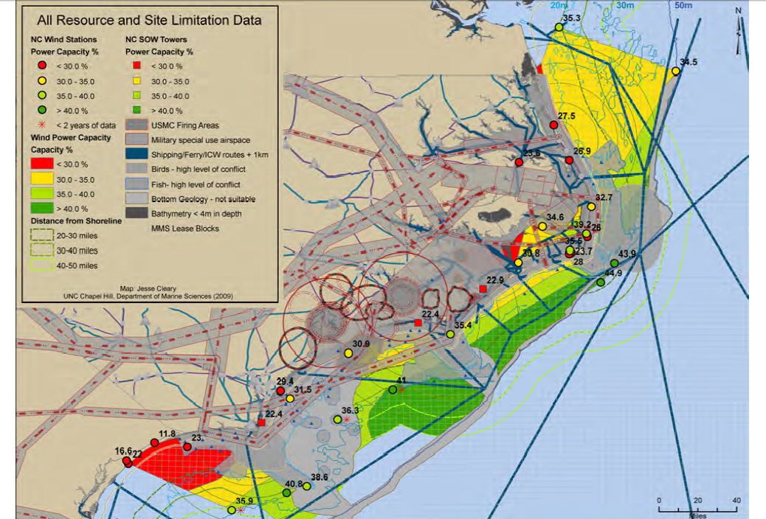
UNC Map of Offshore Wind Resources

