Slide 1
The Opportunities for Distributed Renewable Energy Development in Kentucky
Rory McIlmoil, Downstream Strategies

Slide 2
To begin…

Slide 3
Outline of the report
Introduction to distributed energy
The case for distributed renewable energy
Opportunities for developing distributed renewables
Existing policies
Policy options
Conclusions and recommendations for overcoming barriers
Notes:
(30 seconds)
History:
Part of ‘Coal and Renewables in Central Appalachia’ project (2009)
This report funded by the Blue Moon Fund
Original plan to start in late 2010
Focus of project evolved through discussions with Mountain Association for Community Economic Development (MACED)
Purpose:
To show that…
Kentucky has a substantial amount of renewable energy resources
Most of the resources are best suited for distributed energy technologies
Kentucky needs to diversify its energy portfolio, stabilize energy prices, diversify local/state economies, and reduce impacts of energy production
And that distributed generation from renewable resources…
Is both possible and economical
Can provide a significant source of electricity generation in Kentucky
Would provide substantial benefits for the economy and the environment
It not only possible, but is ALREADY HAPPENING in Kentucky and throughout Appalachia and the United States

Slide 4
Purpose of the report
“Due to immature nature of the development of distributed generation resources, no consideration is given by EKPC to distributed generation in the resource plan.” – East Kentucky Power Cooperative
Our report shows that…
  Kentucky has substantial renewable resources
  Most are best suited for distributed energy
  Kentucky needs to
    Diversify its energy portfolio
    Stabilize energy prices
    Diversify local/state economies
    Reduce impacts of energy production
And that distributed renewable generation…
  Is possible and economical and
  Can provide a significant amount of electricity
  Would benefit the economy and environment
  Is ALREADY HAPPENING
Notes:
(1 min)

Slide 5
What is distributed renewable energy?

Slide 6
Definition we used
“The generation of electricity and heat, or the capture and reuse of waste heat, at or near the point of consumption.”
Notes:
(1 minute) – 3 cumulative
There are many definitions of distributed energy, many of which focus strictly on electricity. But heating is an equally important aspect of energy demand, and in many states such as Kentucky, space and water heat is provided by electricity. This means that replacing centralized sources of heat, either by installing solar or geothermal heating systems or capturing and reusing industrial waste heat, should be included in the definition of distributed generation. Therefore, we used the following definition.

Slide 7
Distributed vs centralized generation
Distributed
  Small generators serving on-site or local energy demand
Centralized
  Remote, large-scale power plants transmitting electricity or natural gas over long distances to a large number of consumers
Many fuels can be used for both centralized and distributed energy
Notes:
(1 min) – 4 cumulative
Distributed generation is pretty much the opposite of centralized generation.
“Centralized” Historically refers mostly to fossil-fuel generators: Coal, nuclear, natural gas, large hydro and geothermal
Renewable energy can also be centralized: Large wind farms and Concentrated Solar Power
And fossil fuels can provide distributed energy: Small gas generators, coal for heating

Slide 8
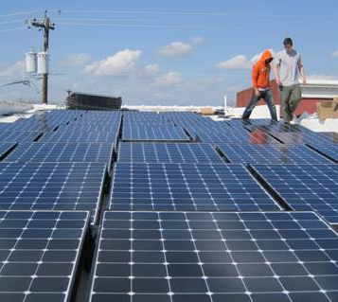
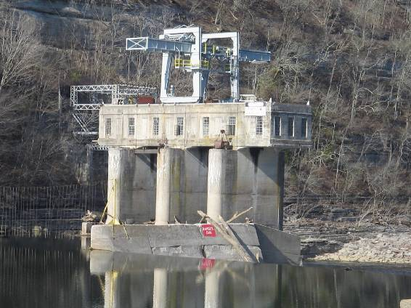

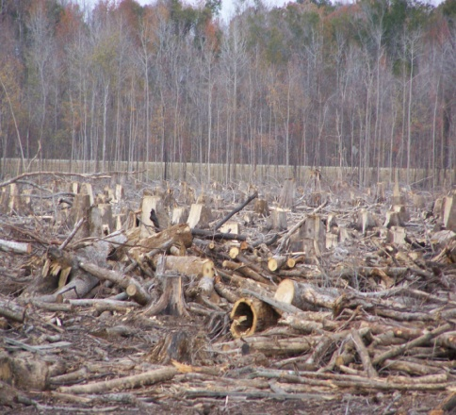
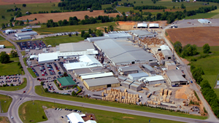
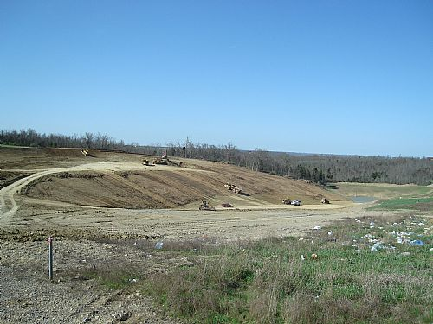
Technologies we examined
Solar PV
Community wind
Combined heat and power
Landfill gas
Forest biomass
Small and low-power hydro
Not shown but included in report: small wind, geothermal heat pumps, solar heating/cooling
Notes:
(1 min)—5 cumulative

Slide 9
Why distributed renewable energy?

Slide 10
Kentucky’s electricity infrastructure is ideal for distributed energy
Share of electricity sales in Kentucky, by type of utility, 2009
Notes:
(1 min)—6 cumulative
Rural electric cooperatives and municipally-owned utilities: Theoretically, greater participation in energy development decisions.
Example: Berea municipal utilities solar project
Significant potential: Co-ops and munis account for 34% of non-TVA electricity sales
Greater dispersion of energy generators

Slide 11
Energy costs in Kentucky are rising fast
Coal and electricity prices in Kentucky, 1990-2010
Notes:
(1 min)
Kentucky: 4th lowest price, but 30th in average household expenses
56% increase in electricity prices from 2000 to 2009
Price of electricity rising as the price of coal goes up
New regulations expected to increase cost of coal generation

Slide 12
Distributed renewables provide significant economic and environmental benefits
Replace inefficient central generators
Provide baseload power and reduce peak demand
Require fewer subsidies than traditional energy
Help stabilize energy prices
Reduce/eliminate costs for new central generators
Reduce electricity losses
Increase energy and grid security
Diversify Kentucky’s energy portfolio and local/state economies
Provide significant environmental and public health benefits
Notes:
(3 min)—10 min cumulative
These are all discussed in greater detail in the report.
Replace inefficient central generators
Centralized coal and nuclear plants operate at 33% efficiency, meaning that only one-third of the energy in the fuel is converted into useful energy. Natural gas plants operate at around 50%. By comparison, combined heat and power systems can achieve 65-97% efficiency because they recycle the waste heat.
Provide baseload power and reduce peak demand
Especially when a diversity of distributed energy is developed.
Require fewer subsidies than traditional energy
Overall, conventional and fossil fuel-based energy industries have historically received far greater subsidies than have renewable energy industries.
Help stabilize energy prices
By reducing the dependency on fuels, such as coal, that experience price volatility.
Reduce/eliminate costs for new central generators
Reduce electricity losses
From transmission and distribution
Losses add to the cost of central generation
Increase energy and grid security
Greater number of small generators dispersed over a wide are decreases the likelihood of large areas losing power in casse of a failure
Also reduces power outages and blackouts by reducing stress on the grid during epriods of high demand
Diversify Kentucky’s energy portfolio and local/state economies
Provide significant environmental and public health benefits
Reducing pollution along the whole fossil fuel lifecycle

Slide 13
Overview of findings

Slide 14
Potential energy generation
Fully developing Kentucky’s distributed renewable energy potential could provide the equivalent of 34% of the state’s electricity generation in 2025
Resource/technology | Percent of capacity developed | Generating potential (million MWh) | Percent 2025 generation
Solar photovoltaic | 0% | 7.4 | 6%
Solar hot water | n/a | 9.8 | 9%
Small/community wind | 0% | 0.1 | 0%
Forest biomass (logging) | 1% | 3.4 | 3%
Combined heat and power | 4% | 13.3 | 12%
Landfill gas-to-energy | 28% | 0.5 | 0%
Small/low-power hydro | 74% | 7.9 | 7%
Geothermal heating | n/a | n/a | n/a
Totals | 8% | 39 | 34%
Notes:
(3 min)—13 cumulative
Notes:
This shows the “equivalent” of electricity generation. Heating with distributed renewable energy technologies may replace either electricity or natural gas.
Used Kentucky Utilities and Louisville Gas and Electric estimates of annual increase in electricity demand (1.5%)
CHP offers the greatest reductions in or replacement of current electricity demand from centralized sources.
No estimates were available for geothermal heating, but it was important to include.
Conservative estimate because it excludes ground-mounted solar PV, small wind potential, other sources of sustainable biomass, geothermal heating, and energy efficiency gains, and provides the conservative estimate for CHP.

Slide 15
Solar resources and development in select Appalachian states
Notes:
(1 min)—15 cumulative
This map shows the solar resource and solar PV development in select Appalachian states, and the states with a Renewable Portfolio Standard are outlined in orange. Each of these states has a solar “set-aside” which we’ll discuss later
Can see the impact that policies supporting renewable energy and solar energy specifically has on solar development
Tennessee doing well because of TVA programs incentivizing renewable energy development

Slide 16
Cost of energy
Installed cost of solar PV in the US, 1998-2010
Notes:
(30 seconds)—15 cumulative
The cost of distributed renewables is on par with the cost of energy generated by most of Kentucky’s utilities from coal and natural gas, or will be in the near future. Solar isn’t the only technology approaching price competitiveness
Especially true given rising cost of coal and new regulations

Slide 17
Job creation
For most distributed renewable energy technologies, total job creation per unit of capacity is greater than for coal, natural gas and nuclear
Average job creation per unit of capacity for solar and conventional fuels
Resource | Construction, installation, manufacturing | Operations and maintenance | Total
Solar photovoltaic | 1.29 | 0.37 | 1.66
Coal | 0.21 | 0.59 | 0.80
Natural gas | 0.03 | 0.77 | 0.80
Nuclear | 0.38 | 0.70 | 1.08
Notes:
(30 seconds)

Slide 18
Local and community ownership
Definition:
  “Local/community ownership”—local residents, a collection of resident landowners, or a community as a whole (city/town) have a significant direct financial stake and decision-making authority
Maximizes the economic benefits of energy production
  More local jobs and revenues than corporate projects
  Revenues stay in community
  Greater economic benefits for owners
  More likely to use local labor
  Local economic diversification
Notes:
(1 min)—17 cumulative
Some states have policy supports for community ownership
Minnesota’s Community-Based Energy Development (C-BED)
Maine's Community-Based Renewable Energy Act.

Slide 19
Policy recommendations

Slide 20
Kentucky needs a mix of policy supports
“To provide long-term support for distributed renewable energy, and therefore ensure that the economic and environmental benefits will continue to grow, Kentucky should look beyond tax incentives and implement more effective and stable policies while improving the existing policies and laws governing interconnection and net metering.”
Notes:
(1 min)—18 cumulative

Slide 21
Recommendations
Strengthen the state’s net metering law
  Important policy driver—enables owners to recover some of their investment through electricity savings
  HB 187 (2012) would have expanded current capacity limits
  Other mechanisms
Upgrade the state’s interconnection standards
  US EPA and Interstate Council for Renewable Energy recommendations
  Purpose should be to encourage distributed energy development
Notes:
(2 min)—20 cumulative
First, to address existing policy barriers and recommendations for improvement:
Net metering
Only minimally supportive of distributed energy
Low individual (30 kilowatts) and aggregate/total (1% of peak load) capacity limits
Restrictive interconnection standards
Govern the connection of small generators to the electrical grid
Considered “unfavorable” for distributed energy by the US Environmental Protection Agency, and given an “F” by the Network for New Energy Choices because of restrictive requirements

Slide 22
Recommendations
Provide more effective financial incentives (detailed in report)
  Tax credits and exemptions
  Performance-based incentives
  Public benefit funds
  Cash grants, rebates and low-interest loans
Implement policies that maximize sustainability and economic benefit
  Policies/standards for sustainable timber harvesting
  Low-Impact Hydroelectric Institute certification
  Output-based emissions regulations for CHP
  Policies supporting community-owned renewable energy development
Notes:
(1 min)—21 cumulative
Provide more effective financial incentives (detailed in report)
Existing financial incentives are insufficient and unsustainable
Very few incentives for promoting distributed renewables
Unsustainable because of expiration dates and reliance only on tax credits
Types/options:
Investment and production tax credits
Other targeted performance-based incentives
Sales and property tax exemptions
Cash grants, rebates and low-interest loans (revolving loan funds)
Public benefit funds
Policies that promote 3rd party ownership and financing

Slide 23
Recommendations
Implement a Renewable Energy Portfolio Standard with distributed energy “set-aside”
  Clean Energy Opportunity Act (CEOA) of 2012 (HB 167)
    12.5% of retail electricity sales from renewable resources by 2022
    Solar set-aside of 1% of electricity sales (should be expanded to cover all distributed technologies)
Develop and implement a Feed-In-Tariff (FIT)
  CEOA would have instituted a FIT
  Guaranteed payment for renewable energy generation for 20-25 years
  Promotes community and individual ownership of energy production
  TVA’s Standard Offer program for renewable energy
Notes:
(3 min)—24 cumulative
these are two means to advancing distributed energy because they (a) require utilities to provide electricity from renewables and (b) "level the Tlaying field" in terms of costs of generating power by giving a boost to renewable sources.

Slide 24
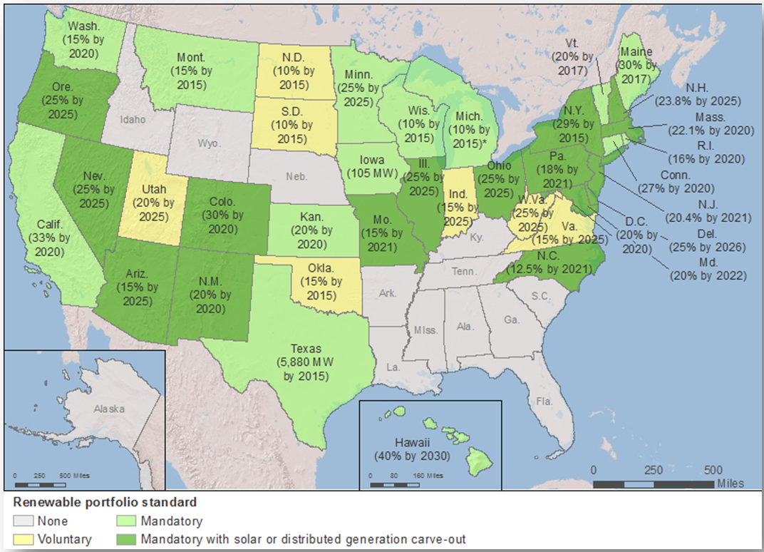
Everybody’s doing it!! (sort of)
Policies and targets for renewable energy portfolio standards in the US (2011)
Notes:
(1 min)—25 cumulative

Slide 25
Distributed renewable energy for the “Land of tomorrow”
“Ken-tah-ten”– Iroquois origin of “Kentucky”—”Land of tomorrow”
Summary
Distributed energy can play a significant role in Kentucky’s energy future
Using existing resources, distributed renewables can provide 34% of Kentucky’s energy needs by 2025
But…achieving Kentucky’s potential will require significant changes in existing policy, and new policies and incentives
Economic and environmental benefits will be significant

Slide 26
For more information
Rory McIlmoil, Downstream Strategies
  Work: (304) 445-7200
  Cell: (304) 376-0045
  Email: rmcilmoil@downstreamstrategies.com
The report can be downloaded at:
www.downstreamstrategies.com
(Click on the “Projects” tab)

